Slide 1
Code Explanation Nov 24

Slide 2

First GUI, to give circuit for

Slide 3
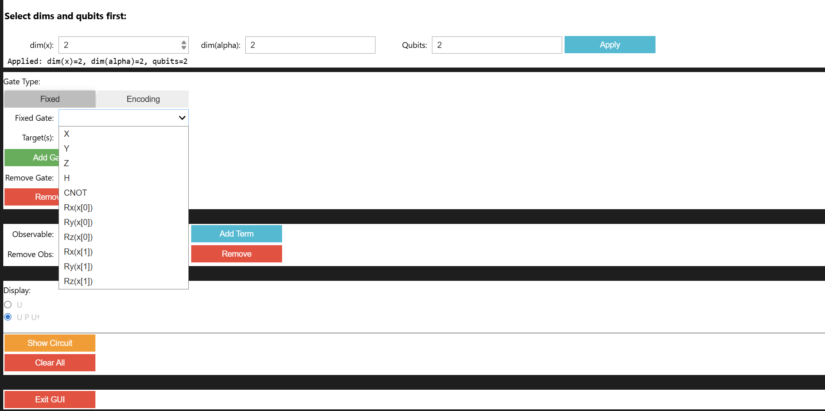
First GUI: Fixed Gates

Slide 4
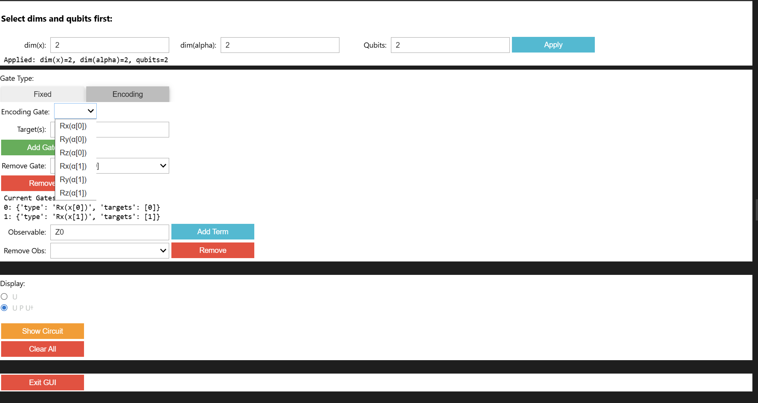
First GUI: Encoding Gates

Slide 5
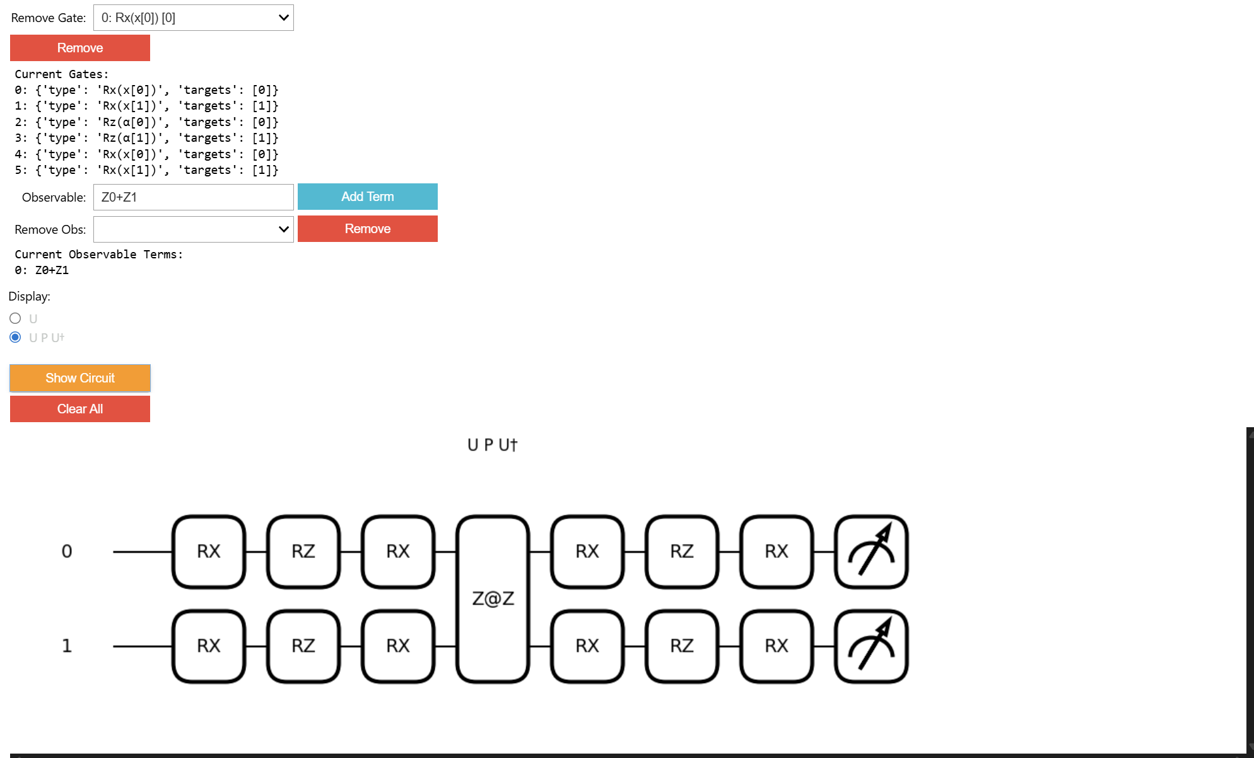
First GUI: Observable and Circuit Diagram

Slide 6
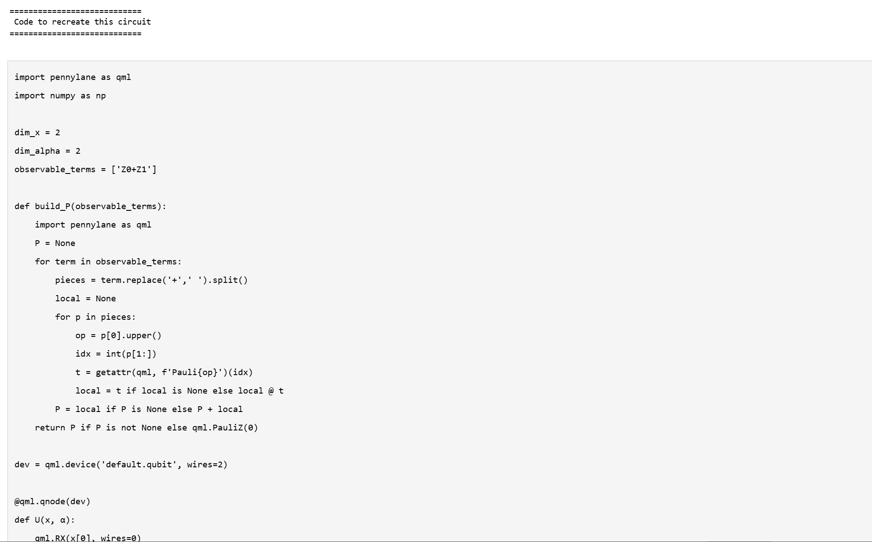
First GUI: Code Output Part 1

Slide 7
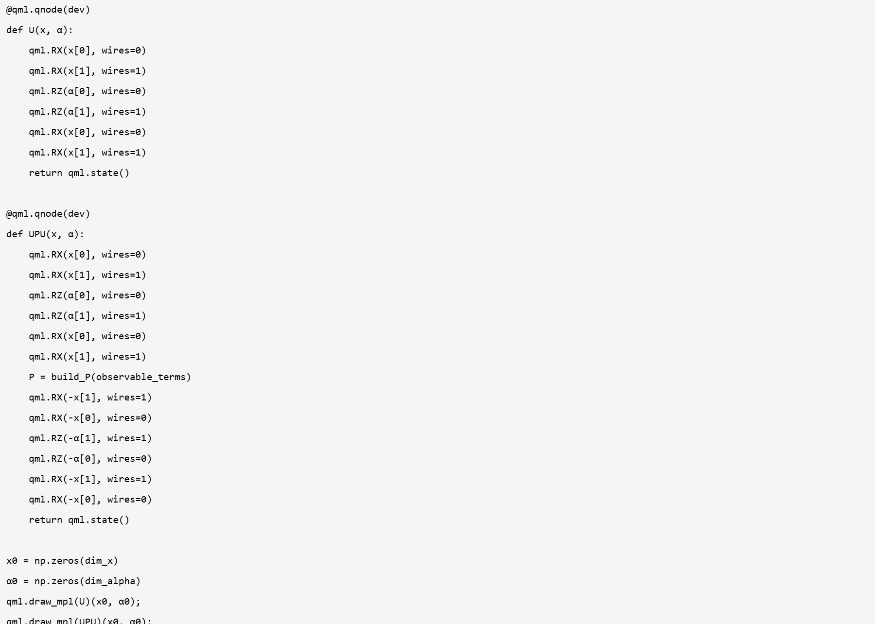
First GUI: Code Output Part 2

Slide 8
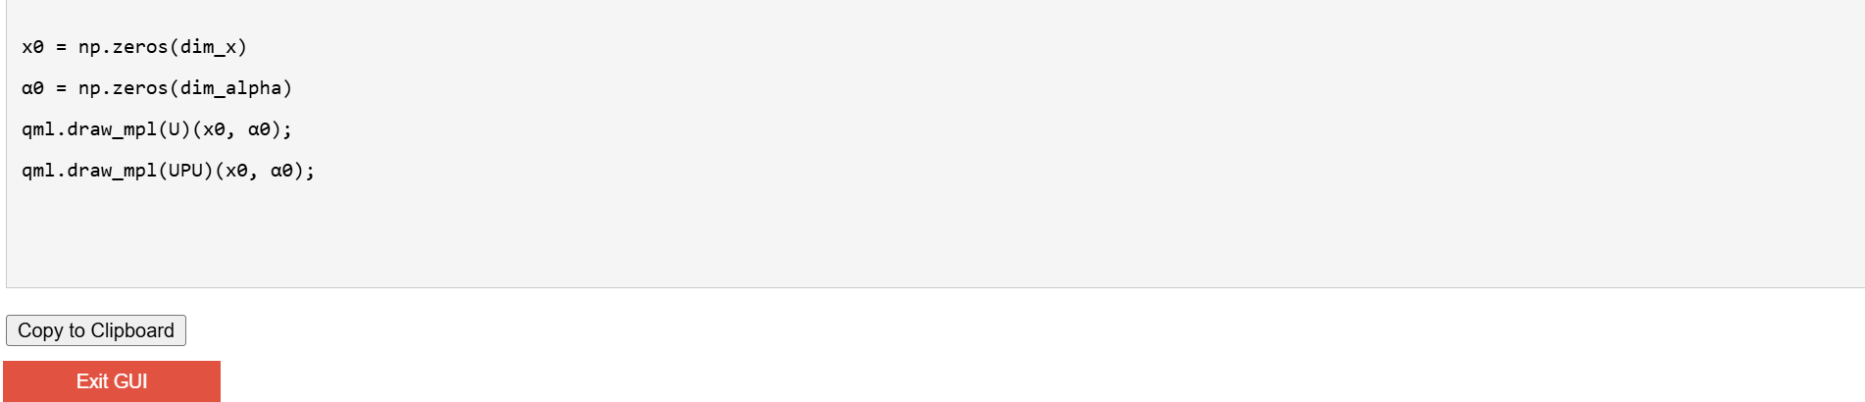
First GUI: Code Output Part 3 with copy button

Slide 9
Second GUI, to apply the algorithm to circuit description

Slide 10
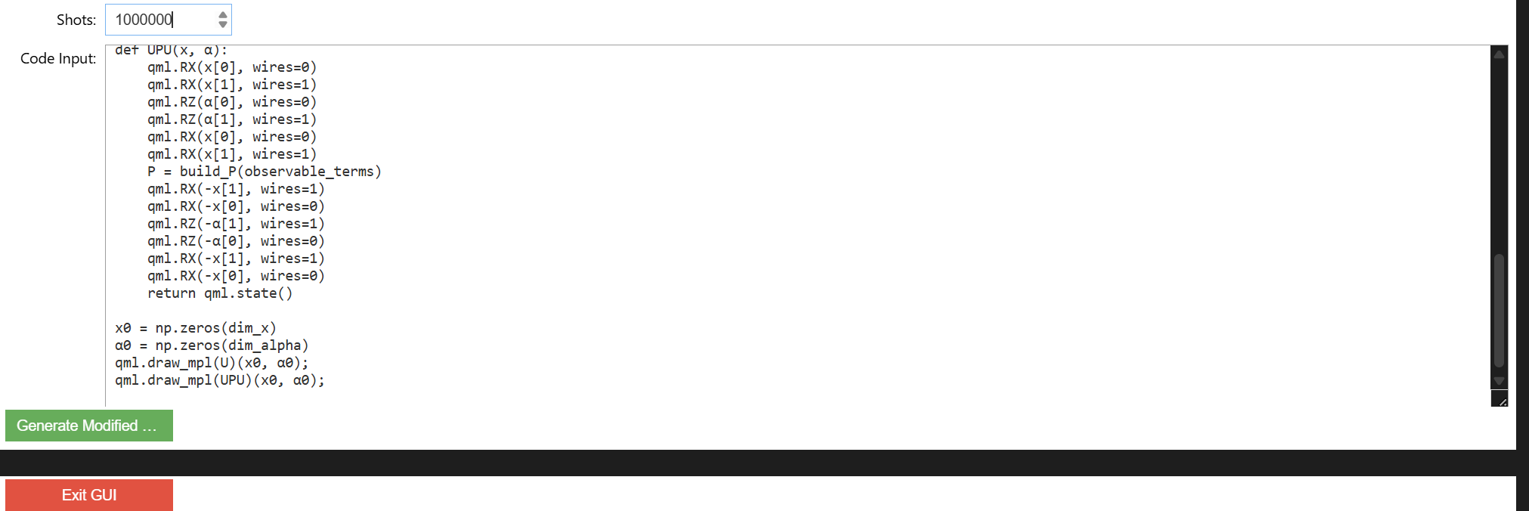
Second GUI: Input circuit from previous and no. of shots

Slide 11
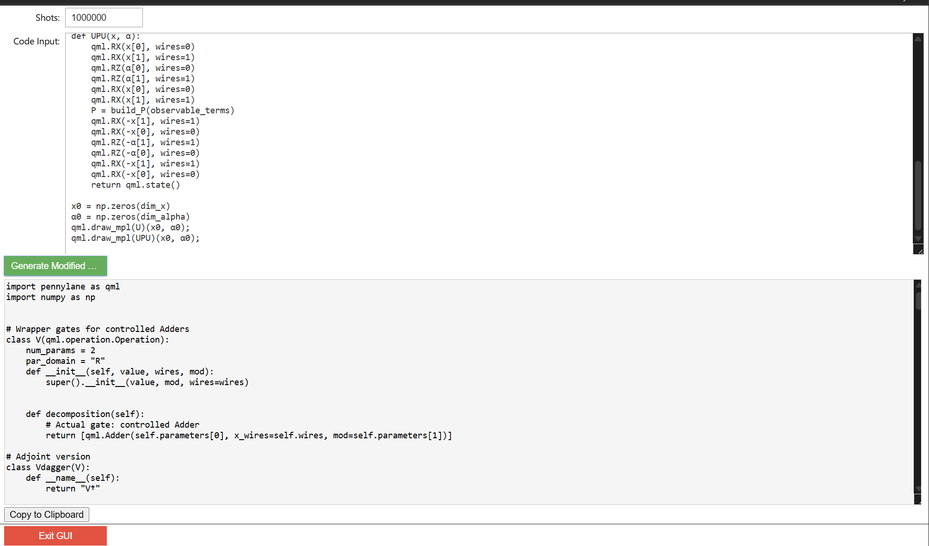
Second GUI: Output code that can be copied

Slide 12
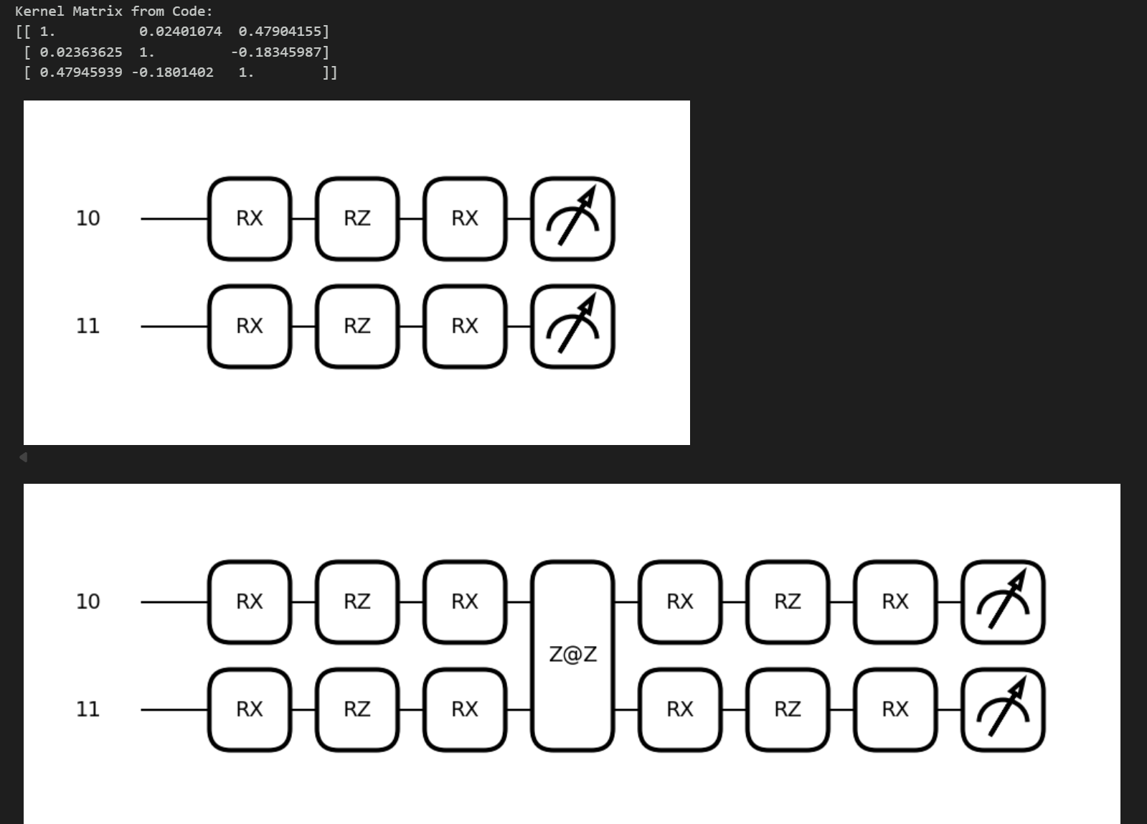
Running the output code of 2nd GUI: Part 1

Slide 13
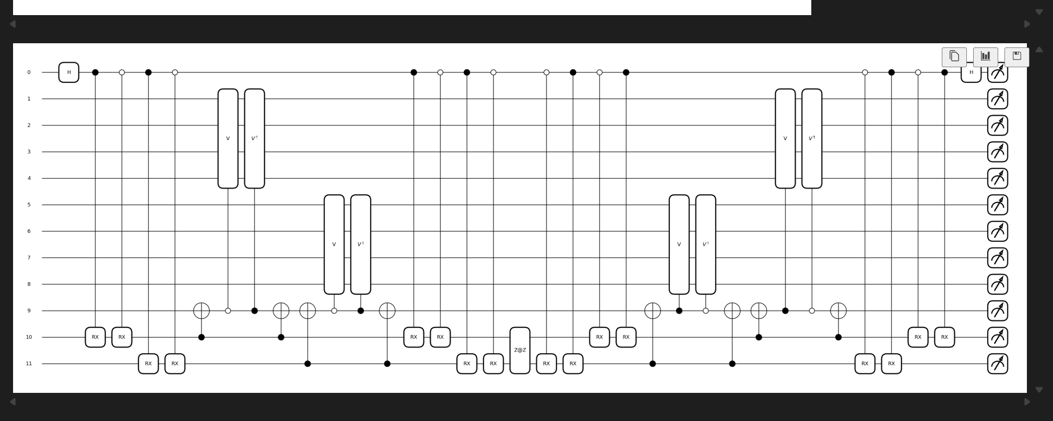
Running the output code of 2nd GUI: Part 2

Slide 14
Comparing Rz(alpha), Rz(alpha)Rz(-alpha)Rz(alpha) and hand calculation

Slide 15
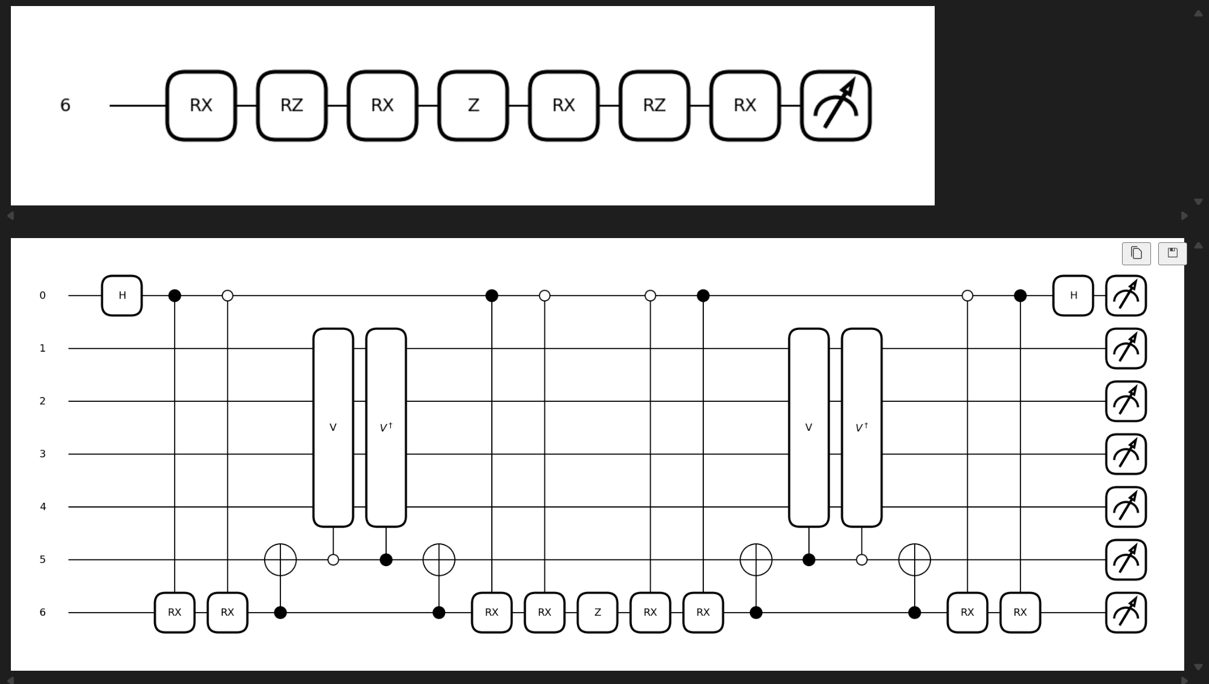
Rz(alpha)

Slide 16
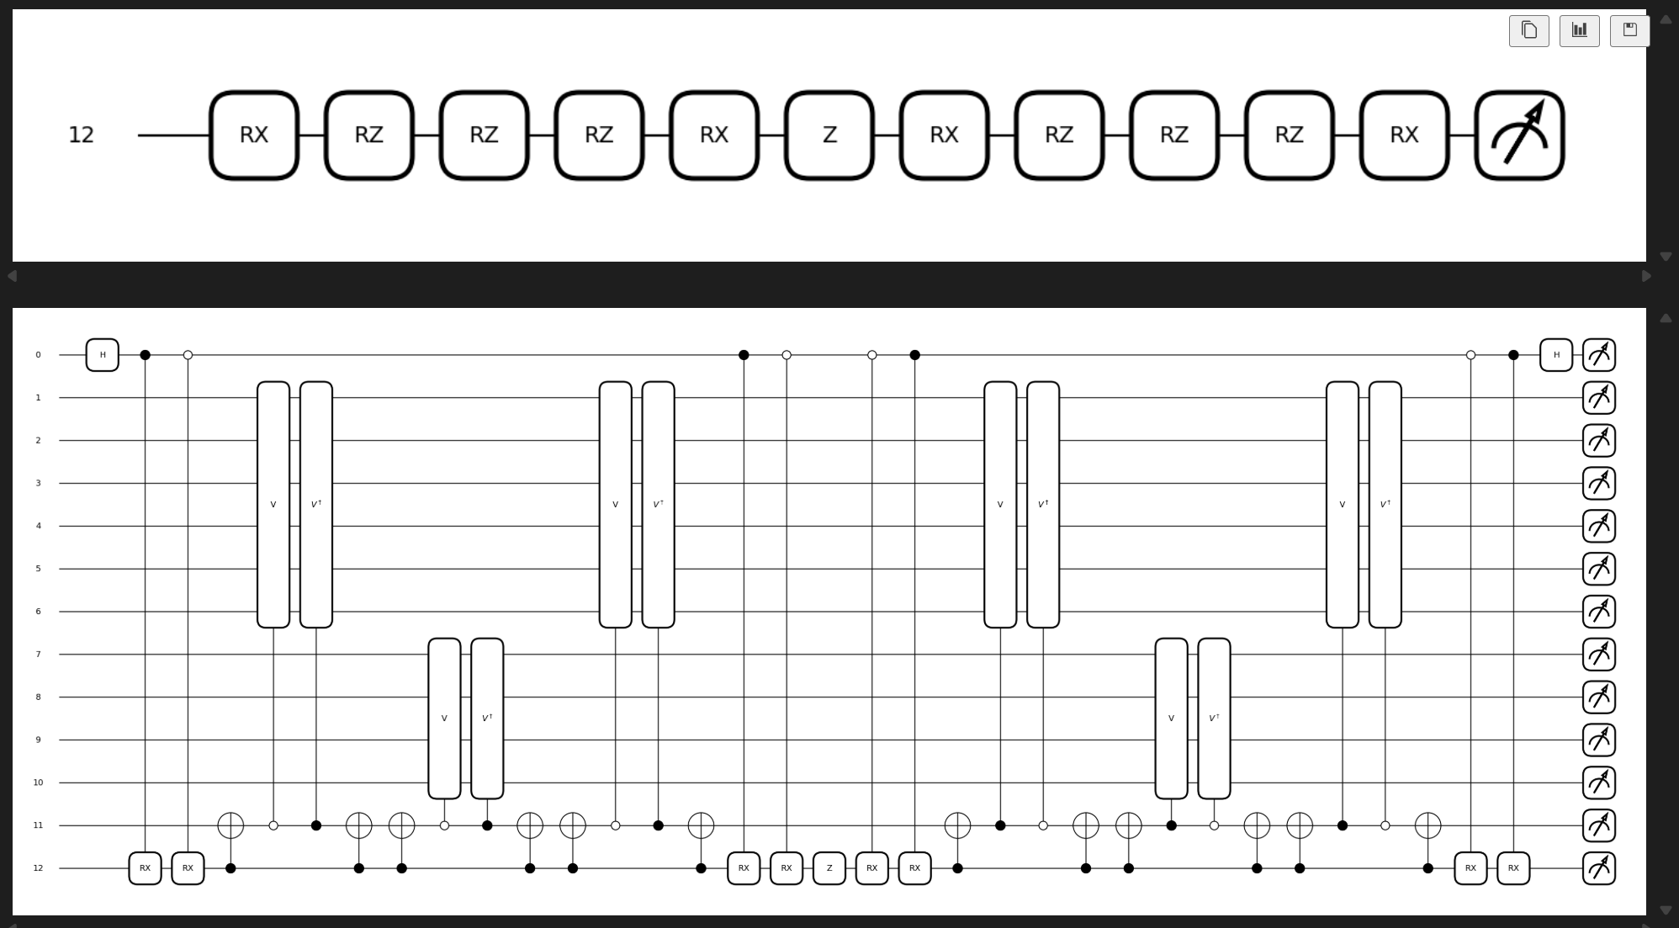
Rz(alpha)Rz(-alpha)Rz(alpha)

Slide 17
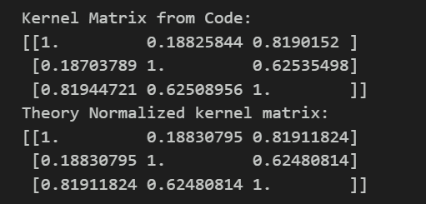
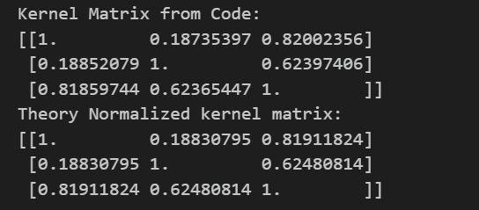
Comparison
Rz(alpha) vs Hand Calculation
Rz(alpha)Rz(-alpha)Rz(alpha) vs Hand Calculation
We can see that all three match upto shot noise. 10^6 shots so shot noise of +- 10^-3

